Slide 1
cant_even_unplug_it
Defcon Qual 2019
You know, we had this up and everything. Prepped nice HTML5, started deploying on a military-grade-secrets.dev subdomain, got the certificate, the whole shebang. Boss-man got moody and wanted another name, we set up the new names and all. Finally he got scared and unplugged the server. Can you believe it? Like that can keep it secret...

Slide 2
https://www.wikihak.com/Subdomains/Subdomains-scanner.php

Slide 3
Redacted-Puzzle
Defcon Qual 2019
Everything you need is in this file.

Slide 4


Slide 5
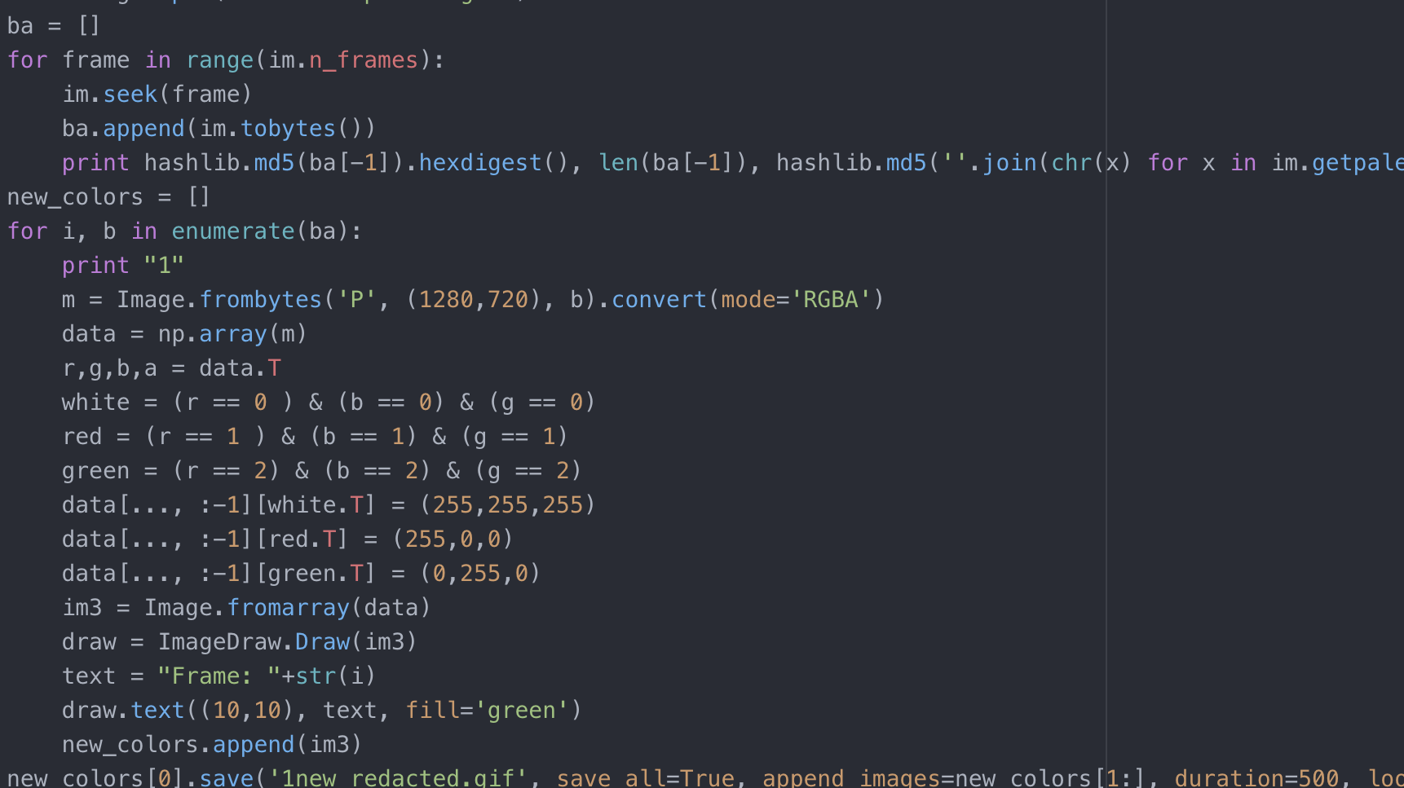

Slide 6
https://amccormack.net/static/img/new_redacted.gif
1 0
0 0
0 0
1 1

Slide 7
OOO{FORCES-GOVERN+TUBE+FRUIT_GROUP=FALLREMEMBER_WEATHER}

